Slide 1
AI applications in Finance
Lecture 10
Introduction to Neural Networks
30-Dec-2020
Indranil Dutta

Slide 2
Agenda – Session 10
Use Case : Bankruptcy Prevention.
Use Case : Credit Risk Assessment.
Use Case : DJIA Prediction
Wrap Up

Slide 3
Use Case:
Bankruptcy Prevention

Slide 4
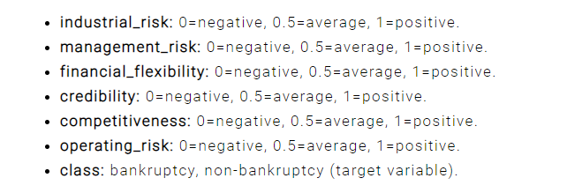
Neural Designer – Use Case – Bankruptcy Protection
  Choose application type -> classification project
    Bankrupt / Not Bankrupt
  Get the data set
    Bankruptcy-prevention.csv
Source : https://www.neuraldesigner.com/learning/examples/bankruptcy-prevention

Slide 5
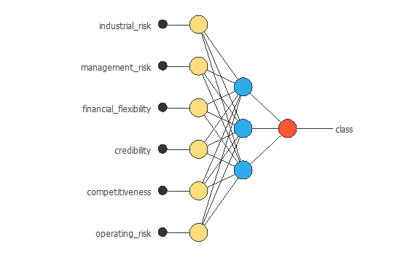
Neural Designer – Use Case – Bankruptcy Protection
  Data instances
    60% training
    20% selection
    20% testing
  See data distribution
    Balanced vs imbalanced
    See the correlations
  Build the network
Source : https://www.neuraldesigner.com/learning/examples/credit-card-fraud#ApplicationType

Slide 6
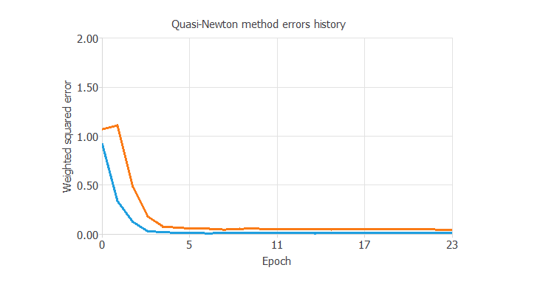
Neural Designer – Use Case – Bankruptcy Protection
  Train the network
    Loss index as default
    Optimization as default
  Model Selection
    Order selection
    Incremental model
  Test the network
Source : https://www.neuraldesigner.com/learning/examples/credit-card-fraud#ApplicationType

Slide 7
Prediction of the
Dow Jones Industrial Average (DJIA)

Slide 8
DJIA
The Dow Jones Industrial Average (DJIA):
  Is also referred to as Dow 30
  Is a stock market index that consists of 30 large, publicly-owned blue chip companies
  That trade on the New York Stock Exchange (NYSE) and the NASDAQ
  The companies are not static but are added or removed according to their relevance to the economy
  Indicator of the health of the US economy.
Source: https://www.investopedia.com/terms/d/djia.asp

Slide 9
DJIA : Prediction task
Input
  Raw data
  Transformed to
Date | Open | High | Low | Close | Volume | Adj Close
2000-01-03 | 11501.85 | 11655.65 | 10862.66 | 11522.56 | 1068760000 | 11522.56
2000-01-10 | 11532.48 | 11908.5 | 11385.74 | 11722.98 | 1033940000 | 11722.98
2000-01-18 | 11719.19 | 11834.67 | 11113.65 | 11251.71 | 1113750000 | 11251.71
Date | MA_5 | MA_10 | MA_20 | MA_60 | MA_120 | Target
2002-04-22 | 10206.85 | 10297.863 | 10118.79 | 10127.81 | 10409.4 | 10006.63
2002-04-29 | 10127.38 | 10301.711 | 10128.57 | 10120.15 | 10396.77 | 9939.92 | <= 10006.63 is the Closing Price On 4/29/2002
2002-05-06 | 10061.04 | 10258.817 | 10123.8 | 10108.41 | 10381.91 | 10353.08 | <= 9939.92 is the Closing Price On 5/6/2002
Source: https://www.investopedia.com/terms/d/djia.asp

Slide 10
DJIA : Prediction task
Input to our model
  Moving averages for
    5 days
    10 days
    20 days
    60 days
    120 days
  Moving average :
    Used in technical analysis of stocks -> trends in price behaviour
    Used to flatten variations in the short term
    Average over the given amount of days.
What is the dimensionality?
We will partition the data for
  Training (70%)
  Testing (30%)
Source: http://www.xlpert.com/software-4Cast-XL.html

Slide 11

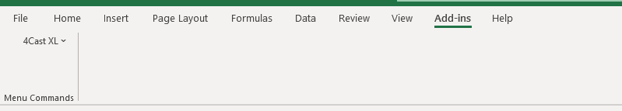
DJIA : Prediction task
Install the Excel plugin. (Files sent in Session 5)
Open the Excel file -> Dow_Weekly
Click on the 4Cast XL Excel plugin
Click on the Enable Macros button when prompted.
Confirm that the link is there on the top ribbon.
Clicking on that ribbon should display the following.
Source: http://www.xlpert.com/software-4Cast-XL.html

Slide 12
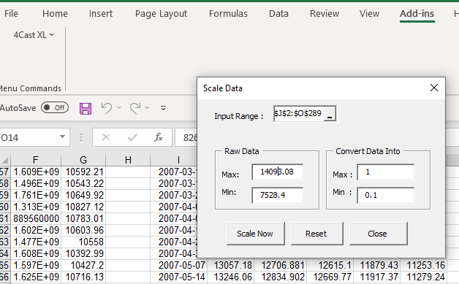
DJIA : Prediction task - 1
Delete the Worksheet named Network Output
Step 1 : Scale the data
    Choose scale data from the add-in
    Choose the input range
    Choose 1 as max and 0.1 as min.
    Click on Scale Now button.
Source: http://www.xlpert.com/software-4Cast-XL.html

Slide 13
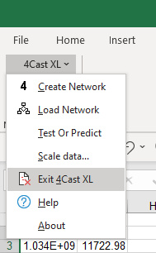
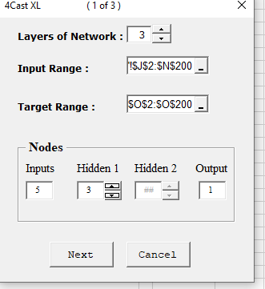
DJIA : Prediction task - 2
Step 2 : Create the Network
    Choose Create Network from the menu
    Enter parameters as shown
    Click Next
Source: http://www.xlpert.com/software-4Cast-XL.html

Slide 14
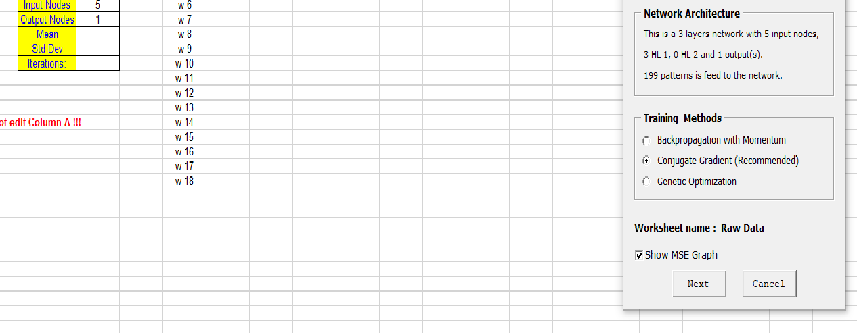
DJIA : Prediction task - 3
Step 3 : Configure the Network
    Choose the training method
    See other parameter as shown
    Verify the Network Output worksheet
    Click Next
Source: http://www.xlpert.com/software-4Cast-XL.html

Slide 15
DJIA : Prediction task - 3
What is the dimensionality?
- Can you calculate the number of weights?
Source: http://www.xlpert.com/software-4Cast-XL.html

Slide 16
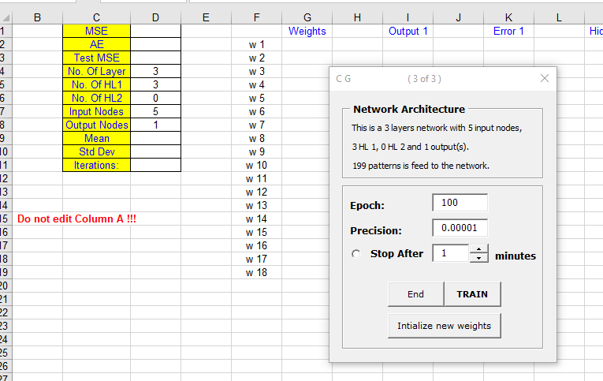
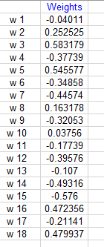
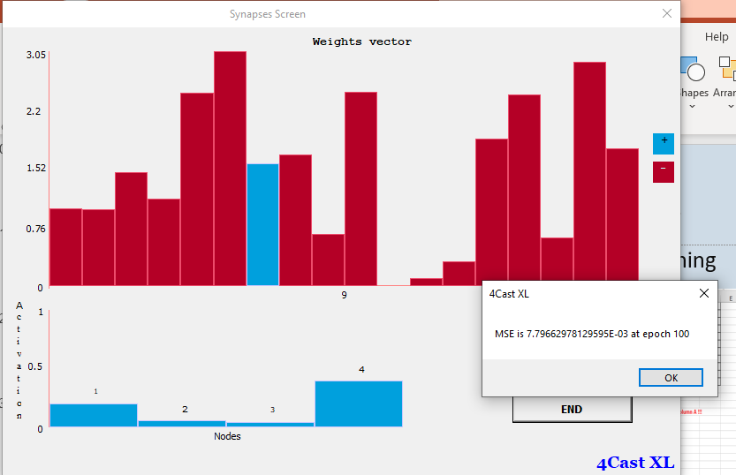
DJIA : Prediction task - 4
Step 4 : Configure the Network for Training
    Choose parameters as shown
    Click on initialize new weights
    Click Train to see screen below
Source: http://www.xlpert.com/software-4Cast-XL.html

Slide 17
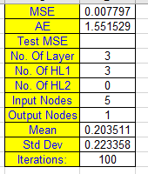
DJIA : Prediction task - 5
Step 5 : Evaluate Training
    See graph of MSE Vs Epoch as below
    Check Network Output tab for details
    Compare calculated vs desired outputs
Source: http://www.xlpert.com/software-4Cast-XL.html

Slide 18
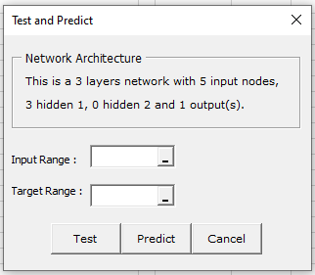
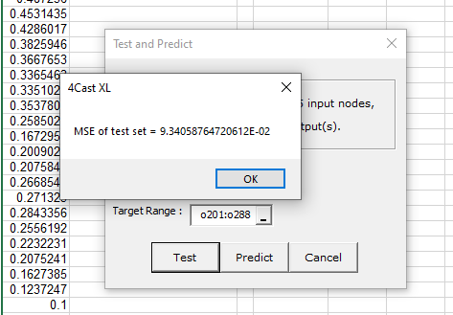
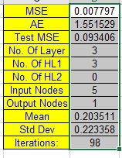
DJIA : Prediction task - 6
Step 6: Test
    Choose test or predict from the 4CastXL menu
    Choose J201:N288 as input range
    Choose O201:O288 as Target range
    Click on the Test button to get confirmation
Source: http://www.xlpert.com/software-4Cast-XL.html

Slide 19
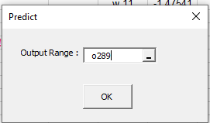
DJIA : Prediction task - 7
Step 7 : Predict
    Choose test or predict from the 4CastXL menu
    Choose J289:N289 as input range
    Choose Target range as blank
    Fill in the output range as below
    See output in blue
Source: http://www.xlpert.com/software-4Cast-XL.html

Slide 20
DJIA : Prediction task - 8
Step 8 : Reverse scale to get value
    Choose scale data
    Input range 0289
    Choose min and max in reverse order
    Get value
Source: http://www.xlpert.com/software-4Cast-XL.html

Slide 21
Use Case:
Credit Risk Assessment

Slide 22
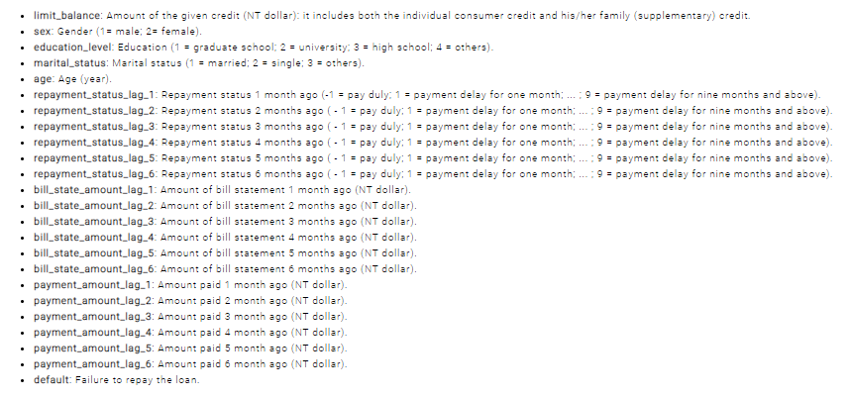
Neural Designer – Use Case – Credit Risk Assessment
  Choose application type -> classification project
    Risk / No Risk
  Get the data set
    credit_risk.csv
Source : https://www.neuraldesigner.com/learning/examples/credit-risk-management

Slide 23
Neural Designer – Use Case – Credit Risk Assessment
  Data instances
    60% training
    20% selection
    20% testing
  See data distribution
    Balanced vs imbalanced
    See the correlations
  Build the network
Source : https://www.neuraldesigner.com/learning/examples/credit-card-fraud#ApplicationType

Slide 24
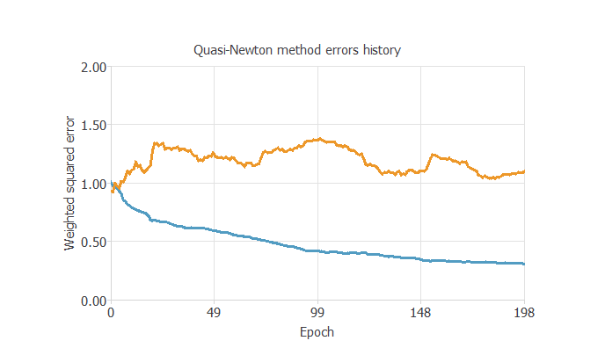
Neural Designer – Use Case – Credit Risk Assessment
  Train the network
    Loss index as default
    Optimization as default
  Model Selection
    Order selection
    Incremental model
  Test the network
Source : https://www.neuraldesigner.com/learning/examples/credit-card-fraud#ApplicationType

Slide 25
Wrap - Up

Slide 26
Wrap Up
  Neural Networks are associated with ‘Deep Learning’
  Addresses 2 categories of supervised learning
    Regression : Predict a numerical value (price of a commodity)
    Classification: Predict outcome (yes /no) or place in a class (bucket)
  Things to keep in mind when designing solution
    Determine the type of problem.
    Examine the data set
      See input correlations
      Examine for missing data
      Examine for outliers
      Break data for
        Training
        Selection
        Testing

Slide 27
Wrap Up
  Choose or examine the tool that is available
  If the tool allows network to be designed
    Design the layers of the network
    Choose the activation functions for each neuron for each layer
    Train the network by choosing
      The loss function (Error + Regularization)
      The optimization method
        Consider speed and memory requirements.
    Test the network
    See how the model can be deployed / used.
  If the tool builds the network in the background
    Check accuracy
    See how the model can be deployed / used.

Slide 28
References
-------------------------------------------------------------
http://www.xlpert.com/software-4Cast-XL.html
https://www.neuraldesigner.com/learning/examples/bankruptcy-prevention
https://www.neuraldesigner.com/learning/examples/credit-risk-management

Slide 29
End of Session
------------------------------------------------------------------
Questions

